Slide 1
Homework Assignment #4
ICMP Message Processing

Slide 2
Outline
Socket API
gettimeofday
ICMP
Homework Assignment #4

Slide 3
Socket API (cont.)
socket
  Create a descriptor for use in network communication
#include <sys/socket.h>
#include <netinet/in.h>
int socket(int domain, int type, int protocol);
EX: sock = socket(PF_INET, SOCK_RAW, IPPROTO_ICMP);
domain:
PF_UNIX: Protocol Family is UNIX
(for local communication)
PF_INET: Protocol Family is IPv4
PF_INET6:Protocol Family is IPv6
type:
SOCK_STREAM: TCP
SOCK_DGRAM: UDP
SOCK_SEQPACKET: SCTP
SOCK_RAW
protocol:
0 ~ 255
  (ref. /etc/protocols. The value 0 may be used to select a default protocol from the selected domain and type)
return value:
successful:
    return a non-negative integer, socket descriptor (sd)
otherwise return -1

Slide 4
Socket API (cont.)
Socket Type
Stream socket | SOCK_STREAM | 1
Datagram socket | SOCK_DGRAM | 2
Raw protocol interface | SOCK_RAW | 3
Reliably delivered message | SOCK_RDM | 4
Sequenced packet stream | SOCK_SEQPACKET | 5
Protocol
IP | IPPROTO_IP | 0
ICMP | IPPROTO_ICMP | 1
IGMP | IPPROTO_IGMP | 2
TCP | IPPROTO_TCP | 6
UDP | IPPROTO_UDP | 17
Send buffer
IP header | ICMP hdr | ICMP data | …
Recive buffer
IP header | ICMP hdr | ICMP data | …

Slide 5
Socket API (cont.)
htons
  Convert the unsigned short integer hostshort from host byte order to network byte order
htonl
  Convert the unsigned integer hostlong from host byte order to network byte order
#include <arpa/inet.h>
uint16_t htons(uint16_t hostshort);
EX: icmp_packet->icmp_seq= htons(seq);
#include <arpa/inet.h>
uint32_t htonl(uint32_t hostlong);
EX:icmp_packet->icmp_otime = htonl(otime);

Slide 6
Socket API (cont.)
ntohs
  Convert the unsigned short integer netshort from network byte order to host byte order
ntohl
  Convert the unsigned integer netlong from network byte order to host byte order
#include <arpa/inet.h>
uint16_t ntohs(uint16_t netshort);
EX: seq = ntohs(icmp_packet->icmp_seq);
#include <arpa/inet.h>
uint32_t ntohl(uint32_t netlong);
EX:otime = ntohl(icmp_header->icmp_otime);

Slide 7
Socket API (cont.)
bzero
  Set the first n bytes of the area starting at s to zero (bytes containing '\0')
inet_addr
  Convert the Internet host address cp from IPv4 numbers-and-dots notation into binary data in network byte order
#include <string.h>
void bzero(char *s, int n);
EX: bzero(&Address, sizeof(Address));
#include <sys/socket.h>
#include <netinet/in.h>
#include <arpa/inet.h>
in_addr_t inet_addr(const char *cp);
EX: address.sin_addr.s_addr = inet_addr(“140.120.15.242”);

Slide 8
Socket API (cont.)
recvfrom
  Receive a message from a socket
sendto
  Send a message on a socket
#include <sys/socket.h>
int recvfrom(int sd, void *buffer, int message_length, int flags,
struct sockaddr *address, int *address_length);
EX: byte_recv = recvfrom(sock, buffer, sizeof(buffer), 0, (struct sockaddr *)&Address, &sizeof(Address));
#include <sys/socket.h>
int sendto(int sd, void *buffer, int message_length, int flags,
struct sockaddr *address, int address_length);
EX: byte_sent = sendto(sock, buffer, sizeof(buffer), 0, (struct sockaddr *)&Address, sizeof(Address));

Slide 9
Socket API (cont.)
close
  Terminate communication and deallocate a descriptor
#include <unistd.h>
int close(int sd);
EX: close(sock);

Slide 10
Outline
Socket API
Gettimeofday
ICMP
Homework Assignment #4

Slide 11
gettimeofday()
gettimeofday
  Get the time as well as a timezone
#include <sys/time.h>
int gettimeofday(struct timeval *tv, struct timezone *tz);
struct timeval {
time_t tv_sec; /* seconds */
suseconds_t tv_usec; /* microseconds */
};
struct timezone {
int tz_minuteswest; /* minutes west of Greenwich */
int tz_dsttime; /* type of DST correction */
};

Slide 12
gettimeofday() (cont.)
ex:
  int main()
  {
  struct timeval start;
  struct timeval end;
  unsigned long diff;
  gettimeofday(&start,NULL);
  delay(10);
  gettimeofday(&end,NULL);
  diff = 1000000 * (end.tv_sec-start.tv_sec)+ end.tv_usec-start.tv_usec;
  printf("the difference is %ld (ms)\n”, diff);
  return 0;
  }

Slide 13
Outline
Socket API
gettimeofday
ICMP
Homework Assignment #4

Slide 14
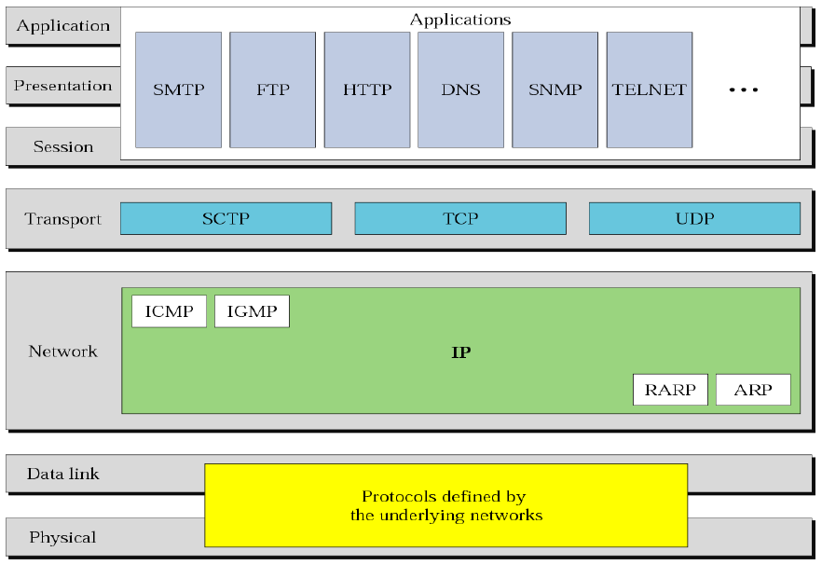
ICMP
Position of ICMP in TCP/IP Protocol Suite

Slide 15
ICMP(cont.)
ICMP Message Format
8-byte header
  The first 4-byte are common to all
    Type(1-byte): define the type of the message
    Code(1-byte): specify the reason for the particular message type
    Checksum(2-byte):in calculated over entire message
  The rest is specific for each message type
A variable-size data section
  For error-reporting message
    Carries information for finding the original packet that had the error
  For query message
    Carries extra information based on the type of the query
IP datagram
IP Header
ICMP Message
20 bytes
Variable length
0
8
16
31
TYPE
CODE
CHECKSUM
Rest of the header
Data section

Slide 16
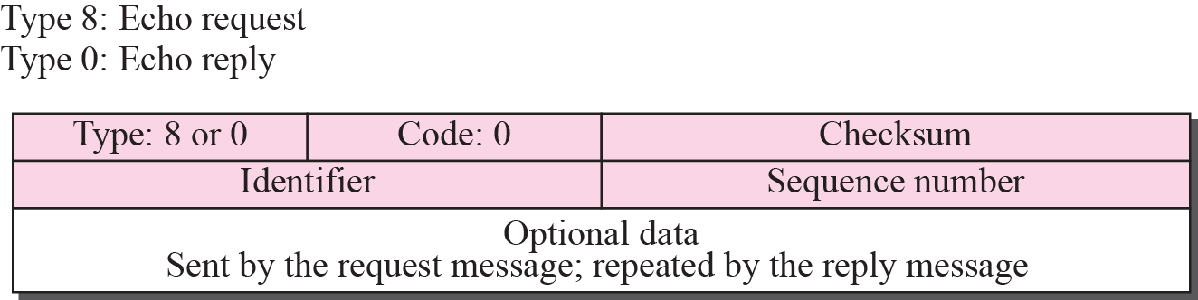
ICMP(cont.)
Echo Request and Reply
    used for diagnostic purposes – two messages in combination determine whether two systems (host and routers) can communicate with each other
    “echo request” and “echo reply” are used by ping when checking if another host is reachable

Slide 17
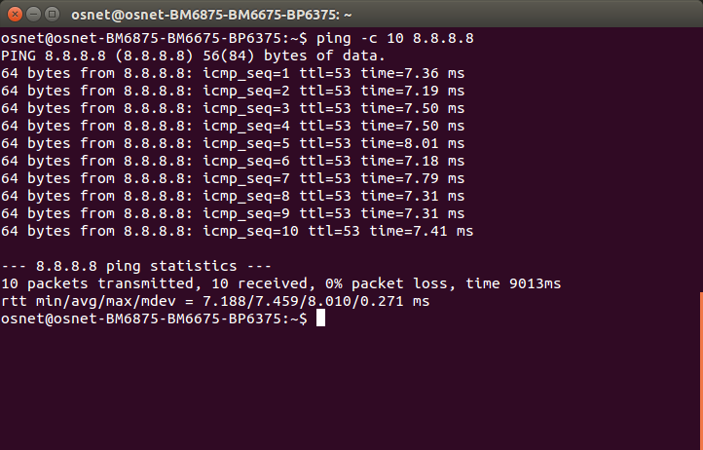
ICMP(cont.)
    Ping example:

Slide 18
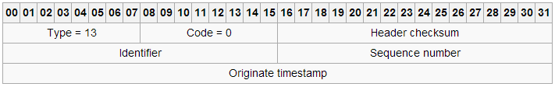
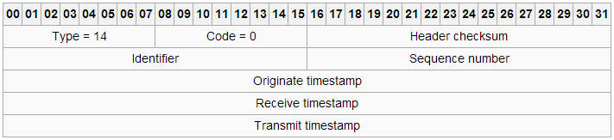
ICMP(cont.)
Timestamp Request and Reply
  Two goals
    Determine the round-trip time needed for an IP datagram
    Synchronize the clocks in two machines
  Timestamp request
  Timestamp reply

Slide 19
ICMP(cont.)
Define icmp structure
  #include <netinet/ip_icmp.h>
    struct icmp {
    u_int8_t icmp_type; /* type of message, see below */
    u_int8_t icmp_code; /* type sub code */
    u_int16_t icmp_cksum; /* ones complement checksum of struct */
    union
    {
    u_char ih_pptr; /* ICMP_PARAMPROB */
    struct in_addr ih_gwaddr; /* gateway address */
    struct ih_idseq /* echo datagram */
    {
    u_int16_t icd_id;
    u_int16_t icd_seq;
    ．
    ．
    ．

Slide 20
Outline
Socket API
Gettimeofday API
ICMP
Homework Assignment #4

Slide 21
Homework Assignments #4
Basic: (70 pts)
  Write a program to simulate the ping application (command) and calculate the RTT value
Advanced: (30 pts)
  Write a program to simulate the ping application (command) and calculate the RTT value

Slide 22



Homework Assignment #4 Basic: (70 pts)
RTT
Calculate
Round-Trip-Time
ICMP echo request
ICMP echo reply

Slide 23
Homework Assignment #4 Basic: (70 pts)
In this work, you are asked to use echo request/reply message to simulate the ping application and calculate the RTT value
  Step1 : Write a program that send a ICMP echo request packet to a host, and receive a ICMP echo reply packet
  Step2 : Furthermore, calculate the Round-Trip-Time (RTT)
  Step3 : Repeat steps 1 through 2 (10 rounds)
  Step4 : Statistic the average RTT, maximum RTT, and minimum RTT

Slide 24
Flowchart
Header
#include <sys/socket.h>
#include <netinet/in.h>
Define: int socket(int domain, int type, int protocol);
The third parameter, protocol, is ICMP
Ex: sd = socket(PF_INET, SOCK_RAW, IPPROTO_ICMP);
Start
Establish
socket
Header:
#include <netinet/ip_icmp.h>
#include <netinet/ip.h>
EX:
struct icmp *icmp_hdr = (struct icmp *) send_buf;
//Define ICMP timestamp
icmp_hdr->icmp_type = ICMP_ECHO;
icmp_hdr->icmp_code = 0;
．
．
icmp_hdr->icmp_cksum=calculate icmp_hdr checksum;
Establish
ICMP
packet

Slide 25
Flowchart (cont.)
Use sendto() function
Ex:
gettimeofday(&start,NULL);
sendto(sd, send_buf, packsize, 0, (struct sockaddr*)&addr, sizeof(addr));
Send
ICMP
request
Use recvfrom() function
Ex:
recvfrom(sd, recv_buf, sizeof(recv_buf), 0, NULL, NULL);
gettimeofday(&end,NULL);
Receive
ICMP
reply
struct icmp *icmp_hdr_recv = recv_buf + ip->ip_hl<<2; //Skip IP header
/* examine the icmp packet*/
．
．
．
RTT = start - end
Calculate
RTT

Slide 26
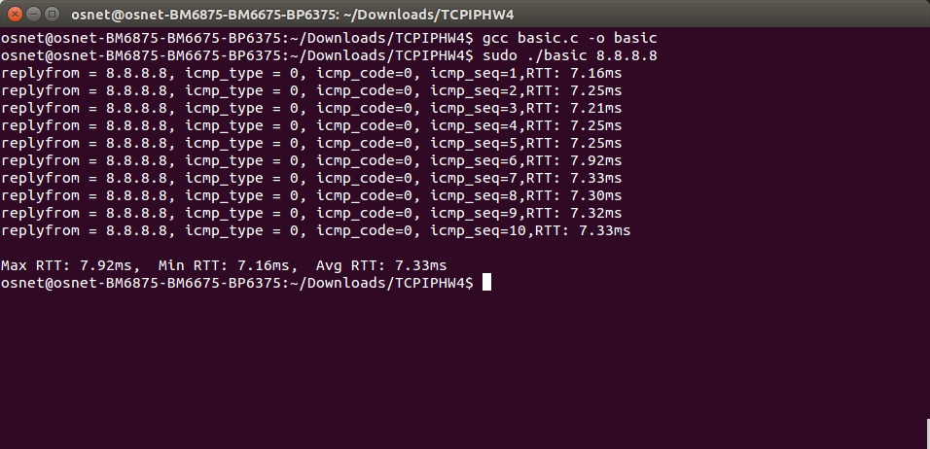
Homework Assignment #4 Basic: (70 pts)
Ex:

Slide 27
Homework Assignment #4 Advanced: (30 pts)
In this work, you are asked to use timestamp request/reply message to simulate the ping application and calculate the RTT value
  Step1 : Write a program that send a ICMP timestamp request packet to a host, and receive a ICMP timestamp reply packet
  Step2 : Furthermore, calculate the Round-Trip-Time (RTT)
  Step3 : Repeat steps 1 through 2 (10 rounds)
  Step4 : Statistic the average RTT, maximum RTT, and minimum RTT
Please describe what is the RTT calculated difference between “echo/reply” and “timestamp/reply”.

Slide 28
Homework Assignment #4 Advanced: (30 pts)
RTT
Calculate
Round-Trip-Time
ICMP timestamp request
T1
T2
T4
T3
ICMP timestamp reply
RTT = (T2 – T1) + (T4 – T3)

Slide 29
Flowchart
Header
#include < sys/socket.h >
#include < netinet/in.h >
Define: int socket(int domain, int type, int protocol);
The third parameter, protocol, is ICMP
Ex: sd = socket(PF_INET, SOCK_RAW, IPPROTO_ICMP);
Start
Establish
socket
Header:
#include <netinet/ip_icmp.h>
#include <netinet/ip.h>
EX:
struct icmp *icmp_hdr = (struct icmp *) send_buf;
//Define ICMP timestamp
icmp_hdr->icmp_type = ICMP_TIMESTAMP;
icmp_hdr->icmp_code = 0;
icmp_hdr->icmp_otime = Use gettimeofday() function;
：
icmp_hdr->icmp_cksum=calculate icmp_hdr checksum;
Establish
ICMP
packet

Slide 30
Flowchart (cont.)
Use sendto() function
Ex:
sendto(sd, send_buf, packsize, 0, (struct sockaddr*)&addr, sizeof(addr));
//packsize at least 12 byte ( ICMP Header 8 byte + Original timestamp 4 byte)
Send
ICMP
request
Use recvfrom() function
Ex:
recvfrom(sd, recv_buf, sizeof(recv_buf), 0, NULL, NULL);
Receive
ICMP
reply
struct icmp *icmp_hdr_recv = recv_buf + ip->ip_hl<<2; //Skip IP header
/* examine the icmp packet*/
Original timestamp (T1)= icmp_hdr_recv->icmp_otime
Receive timestamp (T2)= icmp_hdr_recv->icmp_rtime
Transmit timestamp (T3)= icmp_hdr_recv->icmp_ttime
Final timestamp (T4)
Use gettimeofday() function for T4
RTT = (T4 – T3) + (T2 – T1)
Calculate
RTT

Slide 31
Hint
The gettimeofday() function retrieves the current Coordinated Universal Time (UTC).
ICMP-timestamps, expressed as a number of miliseconds elapsed since last UTC-midnight.
Example:
Icmp_hdr->icmp_otime = (start.tv_sec % (24*60*60)) * 1000 + start.tv_usec / 1000

Slide 32
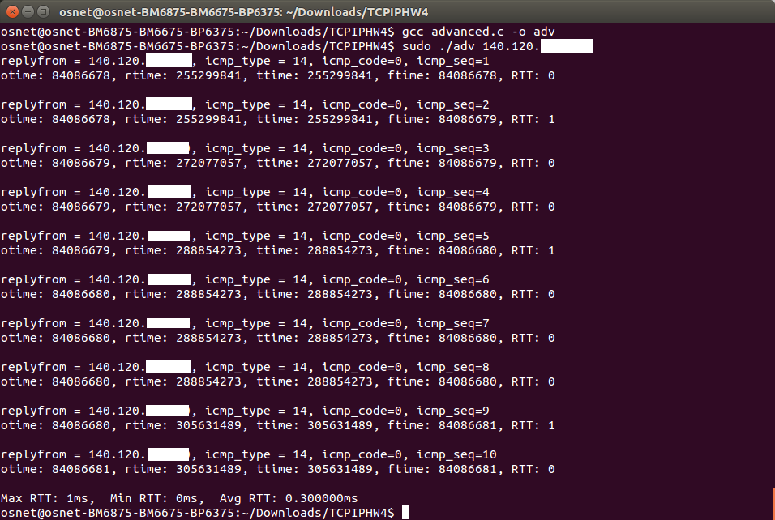
Homework Assignment #4 Advanced: (30 pts)
Ex:

Slide 33
Note
Please use Linux platform
Define ICMP Original timestamp contents
  Not only define icmp_type and icmp_code
Be careful about packet size of sender and receiver
  Send ICMP packet
  Receive IP and ICMP packet
Make sure that all necessary header file be included

Slide 34
Turn in
Deadline
2020/1/1 23:59:59
Upload to i-learning
File name
  HW4_ID.zip (e.g. HW4_7105056035.zip)
    Source code
    Word file
If you want to update
  HW4_ID_New1.zip, HW4_ID_New2.zip….etc
If you don’t hand in your homework on time, your score will be deducted 10 points every day.

Slide 35
TA
Name: 蘇慶軒
Email: khs011342@gmail.com
  Title format: TCP/IP HW# - [your name]
Lab: OSNET(1003A)

Slide 36

ANY QUESTION?

